Slide 1
Misunderstanding and language in Intercultural Communication
Dr Stella Bullo
Senior Lecturer in Linguistics

Slide 2
Outline
Defining ‘misunderstanding’
Exploring types of misunderstandings
Sharing experiences of misunderstandings

Slide 3
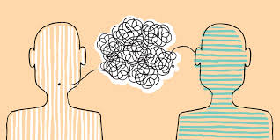
What’s your understanding of ‘misunderstanding’?

Slide 4
Defining ‘misunderstanding’
“potential breakdown point in conversation, or at least a kind of communicative turbulence” (Mauranen, 2006: 128)
‘misunderstanding vs non-understanding’ (Bremer, 1996: 40)
  “the listener achieves interpretation that makes sense to them…but it wasn’t the one the speaker meant”
  “Listener fails to make sense”

Slide 5
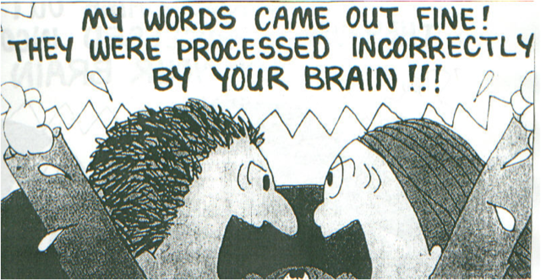
Whose failure? Listener or speaker? Awareness?

Slide 6
Reasons
Inadequate linguistic proficiency
Pragmatic mismatch

Slide 7
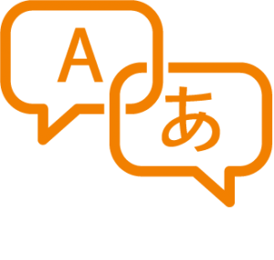
1. Inadequate linguistic proficiency
Participants often use shared language, with different levels of proficiency
Bremer (1996) identifies several problems of understanding at linguistic level
  Lexical
  Phonological
  Syntactic
  Semantic

Slide 8
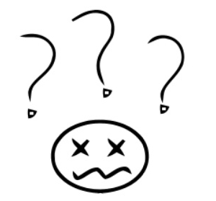
Early days of Stella in Manchester, not used to Manchester accent
Shop assistant: you being served?
Stella: excuse me?
Shop assistant (in exactly same way as before): you being served?
Stella: sorry?
Shop assistant (in exactly same way as before): you being served?
Stella: err…yes
…… 10 minutes later
shop assistant: you being served?
Stella: left the shop without buying anything

Slide 9
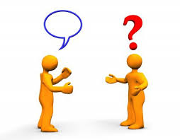
2. Pragmatic mismatch
Misunderstanding can occur when hearers have difficulty in understanding speech acts
Speech acts are acts of communication that express intentions (request, command, etc.)

Slide 10
Pragmatic mismatch
Type 1
Type 2
Type 3
(Thomas, 1983)

Slide 11
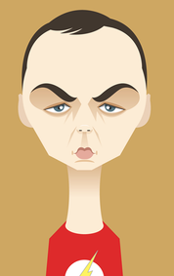
Pragmatic mismatch type 1
Classic Sheldon
Listener’s failure to understand the speech act (request, command, etc.)
  Stella: ‘it’s cold here with the door open’ [I am actually asking for someone to close the door➔ request]
  - Audience: nod
Notes:
https://www.youtube.com/watch?v=1xbYD79_g98

Slide 12

Pragmatic mismatch type 2
Second language users
Speakers may fail to convey what they intend to say hence causing misunderstanding
Inappropriate transfer by L2 speakers

Slide 13


Lost in translation
  Stella and the landlord
    Either way ➔ es lo mismo ➔ it’s the same

Slide 14
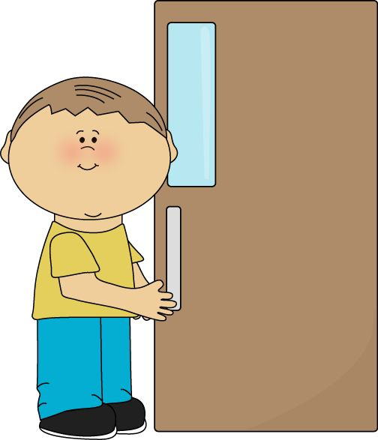
Pragmatic mismatch type 3
Concerned with hidden rules governing the applicability of pragmatic concepts, such as politeness, directness, degree of imposition, social distance
Caused by inappropriate assessment of the degree of imposition, social distance, etc.
L2 users requests and other speech acts; terms of address, etc.
Dr Stella
Spanish use of formal second person imperative ➔ Cierre la puerta ➔ Close the door

Slide 15
Pragmatic mismatch type 4
Pavlenko (2005) and Dewaele (2010)’s research on emotion and multilingualism
  Multilingual speakers perceive the emotional force of the same emotion words (e.g. swear words or love words) differently in the different languages

Slide 16
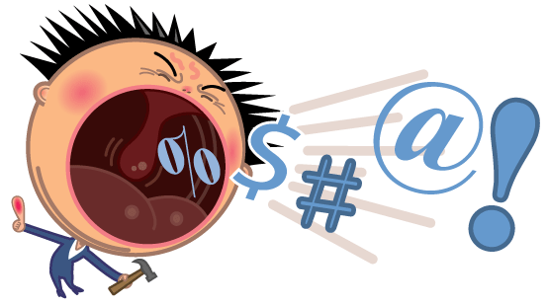
Perceived force of emotional words is correlated with the order in which languages are learned by the speaker
Speakers who learn a language in naturalistic contexts give higher ratings to the emotional force of taboo words than instructed language learners
Speakers of various languages often resort to different languages to express emotions.

Slide 17
All in all…
Misunderstandings occur for a variety of reasons and at different levels
Awareness / understanding
  how, why, who
  Intentions, speakers, message, context
Might help overcome miscommunication

Slide 18
What you have learnt
Area of linguistics called Pragmatics
Concerned with meaning in interaction
Applied to Intercultural communication studies
Year 1 and 2 of BA Linguistics (and combinations) at MMU

Slide 19
References
Bremer, K. (1996). Causes of understanding problems in K. Bremer, C. Roberts, M-T. Vasseur, M. Simonot, and P. Broeder (eds.), Achieving understanding: Discourse in intercultural encounters. London: Longman.
Mauranen, A. (2006). Signalling and preventing misunderstanding in English as Lingua Franca communication. International Journal of the sociology of Language, 6(177): 123-150.
Thomas, J. (1983). Cross-cultural pragmatic failure. Applied Linguistics, 4(2), 92-112.

Slide 20
Task
In groups, think examples of misunderstanding that you have experiences.
Write them in a piece of paper but do not say what type it is
In class, you will discuss your examples in your groups and then exchange your examples with another group who has to decide what type of misunderstanding it is.

